Slide 1
Optimizers Research

Slide 2
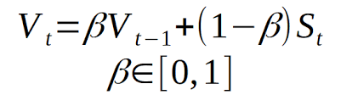
Trade-offs between different optimizers: SGD with momentum
SGD with momentum work by updating weights using a fixed learning rate and a momentum term that makes updates by accumulating past gradients
Momentum helps to accelerate convergence along consistent gradient directions and reduce oscillations in noisy regions
It’s slower initially but stable in the long run
Usually better for generalization
Fine-tuned SGD with momentum can outperform Adam

Slide 3
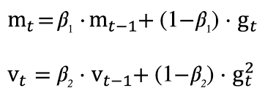
Adam/RMSprop
It adjust the learning rate per parameter, based on past parameter’s magnitude
It’s usually faster
It often reaches low loss within few epochs
Easier to tune and often works creatively

Slide 4
Why Adam/RMSprop may converge faster?
Automatically scales learning rates by gradient magnitude, quickly adapts to different features.

Slide 5
Conclusion
I would recommend SGD with momentum
It may not be faster but more stable
For large datasets it’s going to be more suitable
As mentioned, if Fine-tuned, it’s going to outperform Adam/RMSprop

